Slide 1


REDUCING THE GENDER WAGE GAP

Slide 2
PAY EQUITY AND OCCUPATIONAL SEGREGATION
In almost all countries of the world, women tend to earn less. Why is that?
Exclusion…
Unequal division of family responsibilities results in many women working fewer paid hours and having less access to company-provided training opportunities --
-- and less access to promotion
Discrimination in selection, promotion and skills training due to bias and stereotypical thinking
Exclusion from highly male occupations and channelling of women to more traditional occupations, such as care of others, administration/clerical and sales.

Slide 3
PAY EQUITY AND OCCUPATIONAL SEGREGATION
And also because of historical undervaluing of women’s work:
Concentration of women in caring professions (health and education), clerical and administration, and sales.
Women’s skills are undervalued because they are considered to be “innate” and not learned skills.
Cultural and social attitudes- belief that men, not women, should be breadwinners and heads of household, and that women only need to earn a “second” income.
Sexist bias in evaluating the value of women’s jobs.

Slide 4
Two strategies to reduce the gender earnings gap
1: Eliminating barriers (ILO Convention 111)
Identify obstacles that limit women’s occupational options.
Identify and implement measures to remove these barriers (public policy, collective agreement language, special programs).
Ensure more opportunities for women to enter occupations that have been male “preserves” and that are higher paid.

Slide 5
Two strategies to reduce the gender earnings gap
2: Re-valuing women’s work (ILO Convention 100)
Apply a gender-neutral system of job evaluation that can fully capture and value “women’s work”.
By eliminating the impact of stereotypical judgments about the value of male and female work, all work is evaluated fairly.

Slide 6
The “equal pay for work of equal value” strategy
Highlight the persistent earnings gap between women and men, even when educational levels are the same.
Sign an agreement with the employer to study the requirements of the jobs using a gender lens.
Identify discriminatory ways that the current salary structure affects the way women’s work is paid.
Apply criteria to wage setting that makes both women’s and men’s work more visible.

Slide 7
The “equal pay for work of equal value” strategy
Apply a gender-neutral job evaluation system to determine the value of every job based on its requirements (not on individual performance).
Using a gender-neutral job evaluation ensures equivalencies between very diverse female-dominated jobs and male-dominated jobs
Jobs with comparable total points are compared to make sure their wage levels also match. Any gap between pay for male and female jobs of equal value is corrected.

Slide 8
By implementing a fair system to determine wage rates…
The employer meets the human rights obligations set out in ILO convention100
Any systemic discrimination in the relationship between the wage rates of men and women is identified to correct the under-valuing of traditional women’s work. The labour market value of those occupations is increased.
The concept of equal pay for work of equal value goes beyond equal pay for equal work. It recognizes that men and women often do different, but comparable work.

Slide 9
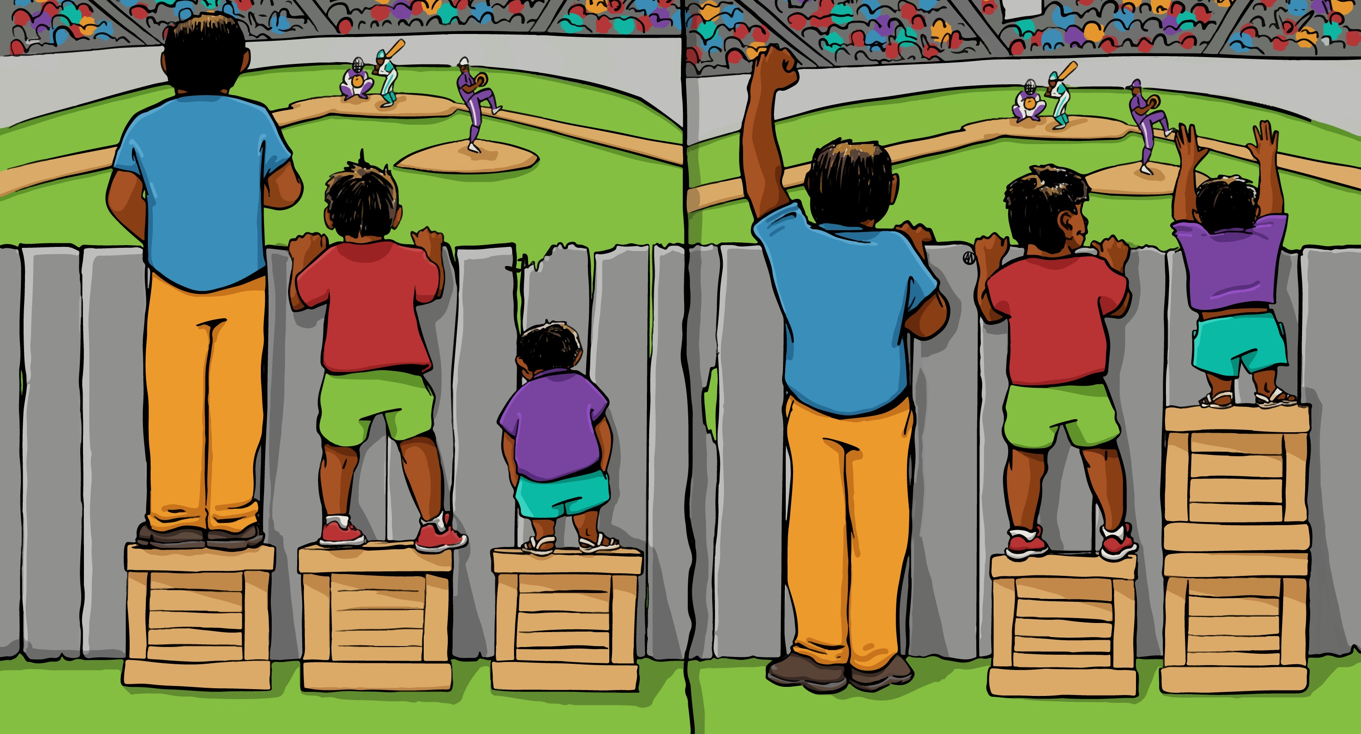
Equal treatment does not always produce an equitable result

Slide 10
A Joint Process
A Joint Committee:
Manages the project
Is trained on the principles of job evaluation and how to incorporate gender perspective
Develops or adapts instruments to ensure evaluations free of sexist bias (capturing and valuing both “female” and “male work”)
Determines which jobs are male and which are female
Decides how to collect information on job requirements
Evaluates the jobs
Carries out comparisons between value (total points) and pay rates
Notes:
Se visibiliza el aporte de las mujeres a los servicios y a la producción de bienes
Se elimina la arbitrariedad en la fijación de sueldos al aplicar un sistema objetivo

Slide 11
Four Criteria (factors)
Skill
Responsibility
Effort
Working Conditions
These criteria are accepted internationally, recognized in Canadian pay equity law and reflect the language of ILO Convention 100

Slide 12
How Jobs are Evaluated
Workers provide a description of the requirements of their jobs and their supervisors review and provide their comments
The Committee applies the same evaluation process and tools to all jobs
The Committee applies the factor weights and compares total scores to identify jobs of comparable or equivalent value
Any wage gap between female jobs and male jobs is identified, and the parties develop and communicate a pay equity plan to implement wage adjustments, if any
Notes:
Se visibiliza el aporte de las mujeres a los servicios y a la producción de bienes
Se elimina la arbitrariedad en la fijación de sueldos al aplicar un sistema objetivo

Slide 13
Model System of
Factors/Subfactors
Criteria (Factors) | SUBFACTOR | # levels | Percentage | FACTOR
SKILL | Education and Experience | 12 | 12% | 38
 | interpersonal Skills | 5 | 8%
 | Reasoning and Analysis | 6 | 12%
 | Physical Skill | 4 | 6%
RESPONSIBILITY | Responsibility for Planning & Coordination | 5 | 10% | 37
 | Responsibility for Others | 6 | 10%
 | Responsibility for Information & Finance | 5 | 10%
 | Responsibility for Material and Programmatic Resources | 4 | 7%
EFFORT | Physical Effort | 5 | 6% | 13
 | Mental Effort | 5 | 7%
WORKING CONDITIONS | Psychological Environmental Conditions | 4 | 3% | 12
 | Physical Environmental Conditions | 4 | 3%
 | Risk of Occupational Injury or Illness | 5 | 6%
 |  |  | 100% | 100

Slide 14
Model Factor and Subfactor Weights

Slide 15
Resources
ILO Model: http://www.ilo.org/global/publications/ilo-bookstore/order-online/books/WCMS_104692/lang--en/index.htm
ILO Study on how to promote pay equity (2006):http://www.ilo.org/wcmsp5/groups/public/---ed_norm/---declaration/documents/publication/wcms_decl_wp_27_en.pdf
Public Services International (PSI) Model – Closing the gender pay gap (2006) http://www.world-psi.org/es/reduciendo-la-brecha-salarial-de-genero and http://www.world-psi.org/sites/default/files/documents/research/en_closing_the_gender_pay_gap.pdf
Government of Ontario Models: http://www.payequity.gov.on.ca/en/resources/case_tools.php
Government of Québec Model (French)– Guide détaillé pour réaliser l’équité salariale et en évaluer le maintien (2015) http://www.ces.gouv.qc.ca/documents/publications/guidedetaille.pdf

